Slide 1

Nature-Based Solutions
Harnessing nature for a resilient future.

Slide 2
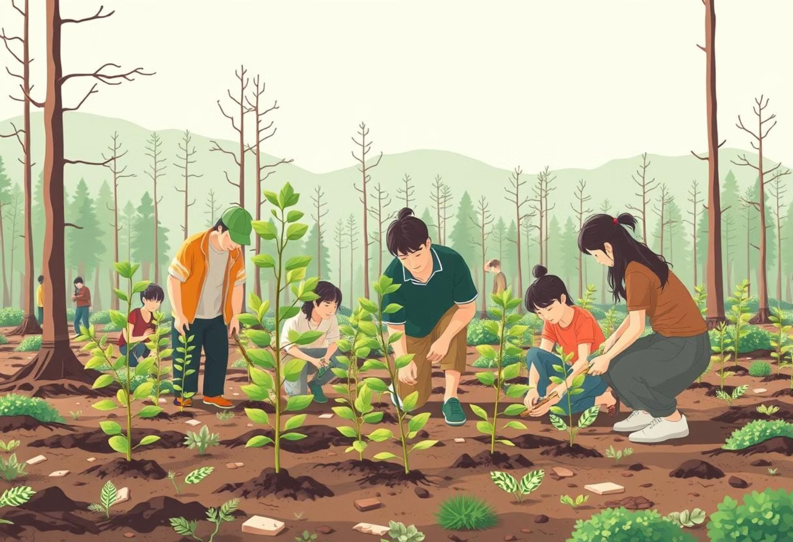

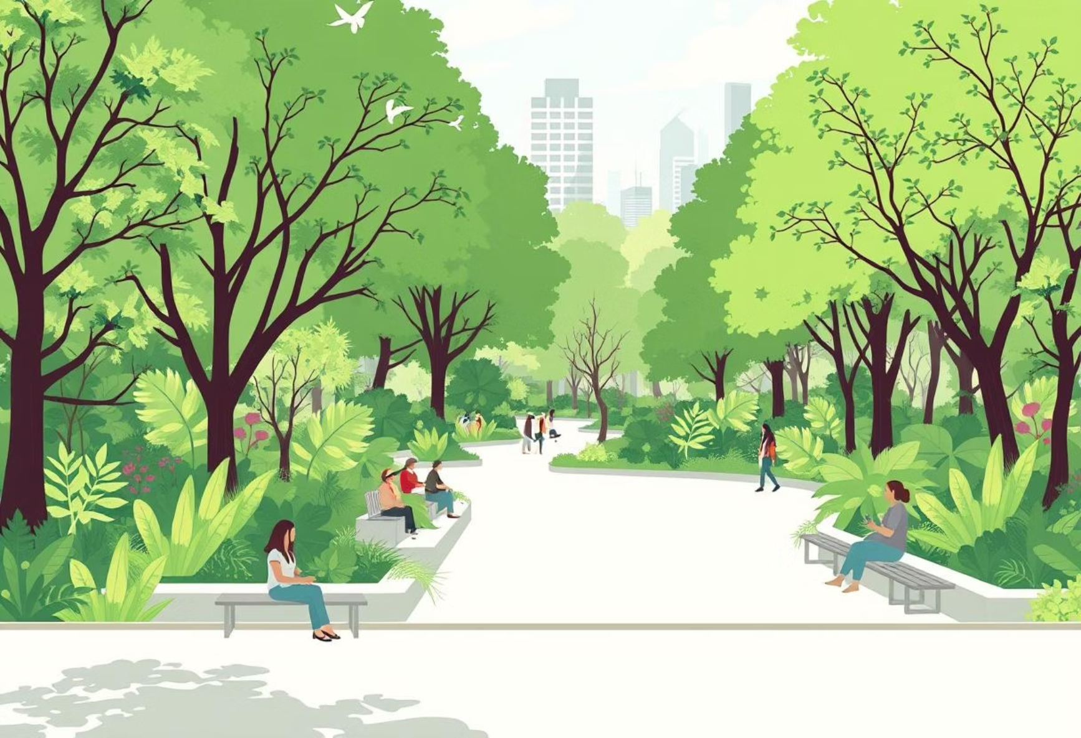
What Are Nature-Based Solutions?
1
2
Definition
Reforestation
Protecting, restoring, or sustainably managing ecosystems to address societal challenges.
3
4
Wetland Restoration
Urban Green Spaces

Slide 3
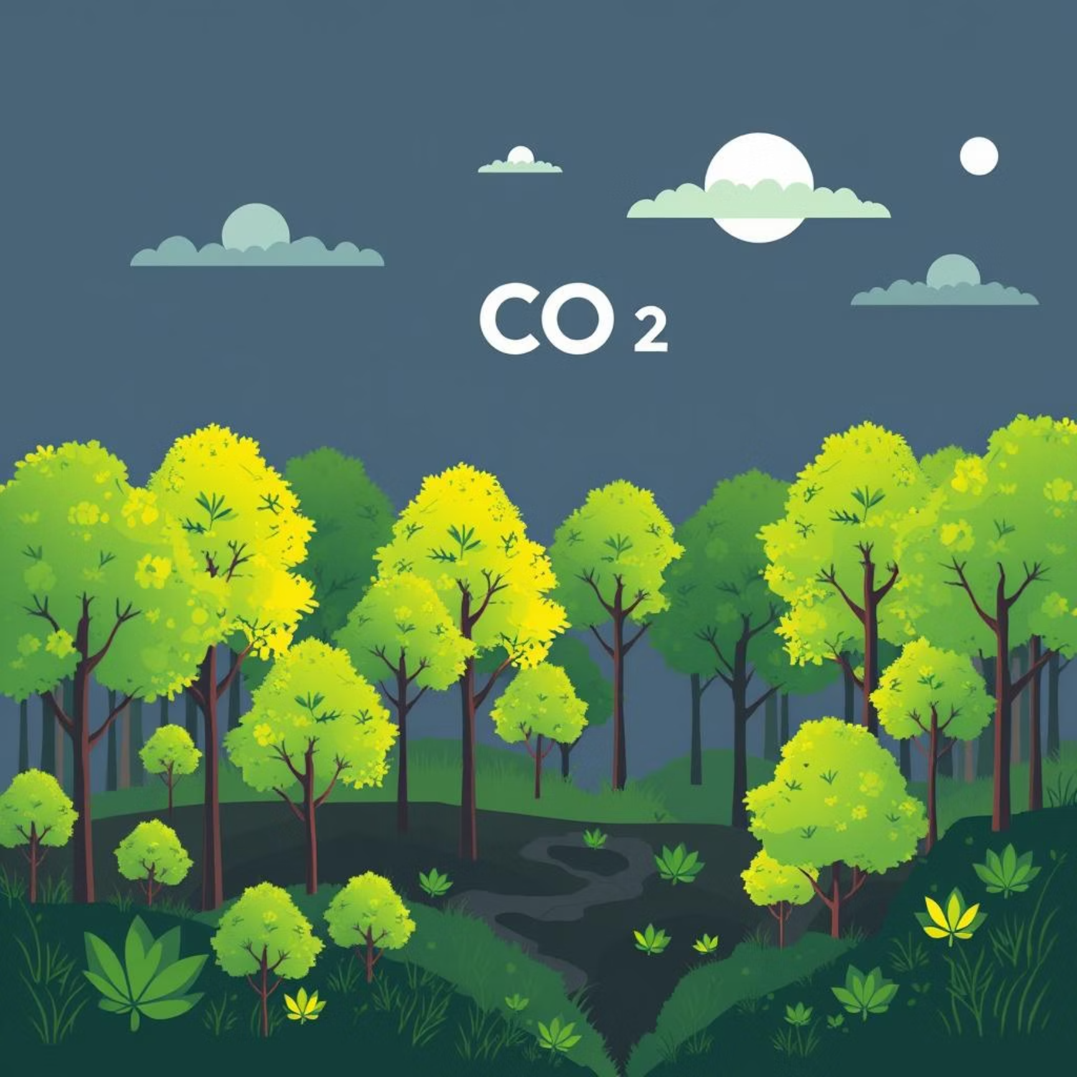

Why NbS Matter
Carbon Sequestration: Nature's powerful tool against climate change.
Biodiversity Conservation: Protecting species and habitats.
Cost-Effectiveness: Often more affordable than engineered solutions.
Community Benefits: Improving health, well-being, and local economies.

Slide 4


Global Success Stories
Rwanda
Great Green Wall (Africa)
National reforestation efforts significantly increasing forest cover.
Combating desertification across the Sahel with a mosaic of land restoration.
China's Loess Plateau
Massive ecological restoration transforming a degraded landscape into a lush environment.

